Slide 1
High level Data Link Layer Protocol - HDLC
Name = Sabyasachi
Roll No. = 16800117031
Dept. = C.S.E
Yr. = 3rd
Subject = Computer Network
Notes:
Note to instructors: This chapter is covered in it’s entirety except for in-depth discussion on character oriented protocols and the detailed analysis frame types and bit patterns. The idea is to have the students understand the concepts, operation and issues surrounding frame based communication. HDLC is the basis for many data link protocols and we use it as our foundation.

Slide 2
High level Data Link Control
Data Link Control – layer 2
  Specifies flow and error control for communication
  Arranges data into frames, supplemented by control bits
  Receiver checks control bits:
    No problem, strips them and passes data;
    Problem detected, communicate with the sender to correct the problem
Notes:
Recall chapter 10

Slide 3
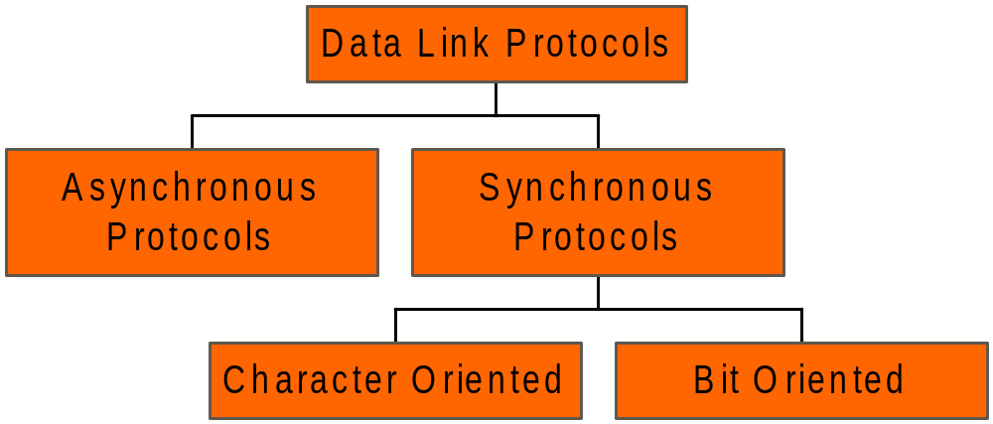
Data Link Protocols

Slide 4
Data Link Protocols
Asynchronous protocols
  Feature Start & Stop Bits, variable-length gaps
Synchronous protocols
  Interprets a transmission frame as a series of characters
  Control information is in the form of an existing character encoding system (ASCII)

Slide 5
Synchronous Protocols
Bit Oriented
SDLC
  Synchronous Data Link protocols
HDLC
  High Level Data link protocols
LAPs
  Link Access procedures
LANs
  Local Area Networks

Slide 6
High-Level Data Link Control
HDLC
Specifications developed by the ISO
Superset of SDLC (used in IBM’s SNA)
Specified as the OSI layer two protocol
Supports half & full duplex over point-to-point and multi-point links

Slide 7
HDLC Station categories
Primary Station (a station than can issue commands)
Secondary Station (a station that issues responses to commands)
Combined Stations (a station can operate as either primary or secondary, issuing either requests, or responses)

Slide 8
HDLC Link configurations
Unbalanced (top)
  Master /Slave
Symmetrical
  One physical station and two logical functions
Balanced (bottom)
  Both stations are the combined type – point-to-point

Slide 9
HDLC Data Transfer Modes
Normal Response Mode (NRM)
  Unbalanced link configuration w/single primary and multiple secondary stations
  Secondary stations can only transfer data when polled by the primary station
Asynchronous balanced mode (ABM)
  Balanced link configuration w/combined stations
  Either station can initiate data transfer at any time

Slide 10
HDLC Data Transfer Modes
Asynchronous response mode (ARM)
  Unbalanced link configuration w/single primary and multiple secondary stations
  Secondary stations are allowed to transfer data without a poll from the primary station

Slide 11
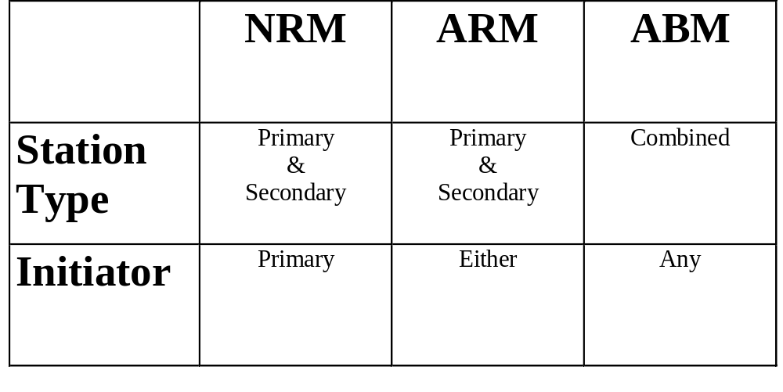
HDLC Modes

Slide 12
General HDLC Frame Format
Sandwich the information between a
header and trailer
DLC Header
DLC Trailer
INFORMATION

Slide 13
Initial Breakdown
01111110
01111110
FLAG FIELD
INFORMATION
ADDRESS
CONTROL
FCS

Slide 14
HDLC Frame Types
Information (I) - carries user data and flow/error control information
Supervisory (S) - used to provide additional flow/error control functions
Unnumbered (U) used to provide for system management
  May carry information for management

Slide 15
FLAG FIELD
Used to indicate beginning and end of the frame
Pattern = 01111110
Zero bit stuffing
  inserting an extra zero whenever there are five consecutive 1s in the data
  receiver does not mistake the data for a flag

Slide 16
ADDRESS
Address of the secondary station for this transmission
8 bit field, 7 bit address (if LSB is a 0, next 8 bits extend the address)
address is all 1’s - broadcast address

Slide 17
CONTROL FIELD
Either 8 or 16 bit field - used for flow management
different for each type of frame
  If start bit = 0 it is an information frame
  If first two bits = “10”, it is a supervisory frame
  If first two bits = “11”, it is an unnumbered frame

Slide 18
Specific HDLC
Control Bits: I, S, U
1 2 3 4 5 6 7 8 9
0
N(S)
P/F
N(R)
1
0
S
P/F
N(R)
1
1
M(1)
P/F
M(2)
N(S) = sequence number of I frame being sent
N(R) = sequence # of next expected I frame
P/F = poll/final bit
S = supervisory frame code
M(1) M(2) = unnnum. code

Slide 19
HDLC Operation - Initialization
Alerts the other side that initialization is requested
Indicates which of the three modes (NRM, ARM, ABM) is to be used
Indicates whether a 3 or 7 bit sequence number is to be used during the exchange
Accomplished through the unnumbered control format
Notes:
The examples that were part of this slide set were removed because they are not consistent with the format provided in the book. There are several examples of operation frame flow on pages 351-7. An example is included.

Slide 20
HDLC Operation - Disconnect
Either sender or receiver can initiate a disconnect
sends a DISC frame
disconnect is accepted with a reply of UA

Slide 21
HDLC - summary
Extensive and flexible data link protocol
Many subsequent link access procedures were derivatives of this

